Slide 1





The Role of Theory in Industrial/Organizational Psychology Research and Practice
Jeffrey M. Cucina (Debater & Co-Chair)
U.S. Customs and Border Protection
Jessica M. Nicklin (Moderator & Co-Chair)
University of Hartford
Neal Ashkanasy (Debater)
The University of Queensland, Australia, Business School
Jose M. Cortina (Debater)
George Mason University
John E. Mathieu (Debater)
University of Connecticut
Michael A. McDaniel (Debater)
Virginia Commonwealth University
Notes:
Nicklin – Welcome audience, state name, and organization for each debater

Slide 2
Today’s Debate
Increased, but controversial, emphasis on the role of theory in I/O psychology in recent years.
Five SIOP members will:
  Define what theory is
  Discuss
    Theoretical contributions
    Good/bad theories,
    Management vs. psychological research
    Big data
    Atheoretical empirical findings,
    Implementing theories in organizations.
Notes:
Nicklin - Aguinis, Bradley, and Brodersen (2014) described the increased role of theory in our field as more Industrial/Organizational (I/O) psychologists move from psychology departments into business schools. Similar observations have been noted by other I/O psychologists. Nearly 20 years ago, Sutton and Staw (1995) observed that the Journal of Applied Psychology (JAP) and Personnel Psychology were largely empirical and deemphasized the role of theory; this is no longer the case today. However, SIOP President Cortina (2014) states “I see a lot of problems with the way we think about theory…. the requirement…that a paper has to make a theoretical contribution is kind of insane….we have a proliferation of theory that no one ever tests, at least not more than once. It’s kind of a bizarre way to conduct a scientific field” (p. 11). Kepes and McDaniel (2013) also criticized the recent overemphasis of theory in I/O-related journals, noting a dramatic increase in emphasis on theory from the editorialships of Schmitt (1989) to Kozlowski (2009).
In today’s debate, five SIOP members will discuss the role of theory in I/O research and practice. The session will begin with each debater presenting a five-minute presentation describing how they personally define theory and their beliefs about the role of theory in I/O research. Next I, the moderator, will present a series of questions to the panel, allowing each panelist an opportunity to respond to the question

Slide 3
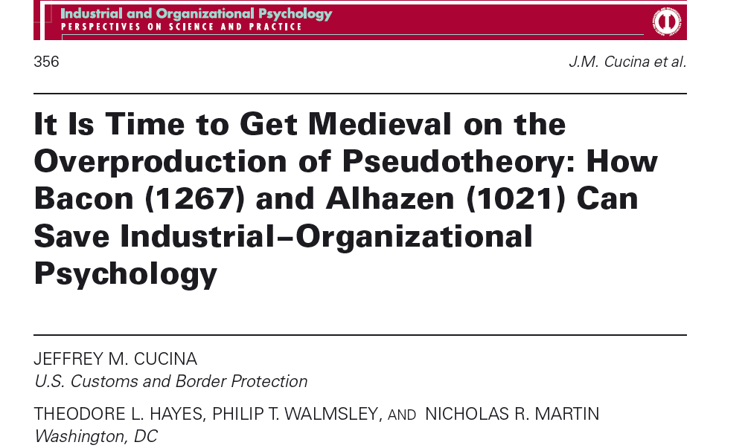

Cucina
I Describe Theory Using the Scientific Method
I/O psychology is a science
We are “scientist-practitioners”
SIOP’s motto is “Science for a smarter workplace”
Historically, I/O has operated as a science
  Previously, our flagship journals published short, empirical papers
Now there is a strong emphasis on “theory” and what I call “creative writing”
We are starting to treat our work more as an art than a science
We need to return to the scientific method

Slide 4
Cucina
The scientific method
Make an observation
Form a question
Write a hypothesis
Make a prediction (i.e., if the hypothesis is true, then the prediction will be true)
Test hypothesis using experiment or observation
If test supports hypothesis, then make new tests for hypothesis. If test does not support hypothesis, then revise or create new hypothesis
Repeat steps 1-6 many times. Only if a hypothesis is supported after many replications can it become a theory.
Reproduced from Cucina, Hayes, Walmsley, & Martin (2014)

Slide 5
Cucina
Characteristics of a theory
  Well-studied
  Well-replicated
  Well-supported,
  Empirical finding
  As close to absolute truth that we can get in science.
Characteristics of a hypothesis
  Speculative
  An educated-guess
  A prediction based on thoughts, conjecture, or anecdotes

Slide 6
Cucina
What I/O theory is becoming
  Speculation based on case-studies and anecdotes
  (n = 1) or guesswork and thoughts (n = 0).
  An author’s personal viewpoints and beliefs
  Overly elaborate “filigrees”
What an I/O theory should be
  A concise statement about the relationship between variables. The relationship should be supported using large-scale meta-analyses or large datasets (large n and large k)

Slide 7
Ashkanasy
So what is theory?
AMR seek to publish “carefully crafted conceptual articles that challenge conventional wisdom concerning all aspects of organizations and their role in society.”
Huffman (2012):, “theory is based on a systematic, interrelated set of concepts that explain a body of data” (emphasis added)
Theories are what enable us to make observations and to conduct experiments to test the veracity or otherwise of theory.

Slide 8
Ashkanasy
Theory 101
Lewin (1947): “There is nothing so practical as a good theory.
Key terms:
  Ontology: the nature of things)
  Epistemology: how we might study ontology)
    Inductive (particular → general) logic
    Deductive (general → particular) logic

Slide 9
Ashkanasy
What theory is not
An epistemology of “transductive” (particular → particular) logic
Leads to logical fallacies such as cum hoc ergo procter hoc, where the observation of two event co-occurring leads to the fallacious conclusion that they must be related.

Slide 10
Cortina
A Conversation on a Plane
Evolution and Creationism are just theories
So neither is superior
But creationism isn’t a theory in the true sense
I wonder if the same could be said for many of our “theories”

Slide 11
Criteria for good theories
Cortina
Ever seen a counterintuitive hypothesis?
Odds that it is supported by the data in that paper are excellent
HARK, the cannon roars!
If we start with the conclusion, we end up looking silly (i.e., illogical).
The current system forces us to start with the conclusion

Slide 12
Prior observation and theory
Cortina
Sometimes we do this right
Other times, we wrestle our pet variables into the next model
On the flipside, we refuse to consider work that questions established wisdom
Kluger and DeNisi (1996)

Slide 13
Revision through replication
Cortina
By requiring papers to make a theoretical contribution, we guarantee that they don’t
Nothing gets replicated
So, nothing gets pruned
The difference between theories of org functioning and creationism is between zero and one study

Slide 14
Early days
Cortina
JAP, up through 50 years ago, had very little theory
Now, Intros are much longer than Methods
So, how much more “theory driven” are we?

Slide 15
Not sure
Cortina
Our theories don’t really result from systematic study of org phenomena
They are subjected to little or no empirical scrutiny
Are we scientists uncovering and disseminating reality?

Slide 16
Or
Cortina
Are we proselytizers trying to get others to want to believe our hypotheses as badly as we want to believe them?

Slide 17
Too much emphasis on theory?
Cortina
We used to be too dustbowlish
We used to be reporters, and occasionally testers (Colquitt & Zapata-Phelan, 2007)
“Reporting” has been gone for 25 years, and “testing” is almost extinct
How much is too much theory?
Is it time to push the pendulum back in the other direction?

Slide 18


The Problem with [in]
Management Theory
John Mathieu
UConn

Slide 19
Bacharach, 1989
“A theory is a statement of relations among concepts within a set of boundary assumptions and constraints. It is no more than a linguistic device used to organize a complex empirical world (p. 496).”
Not descriptions, typologies, or metaphors

Slide 20
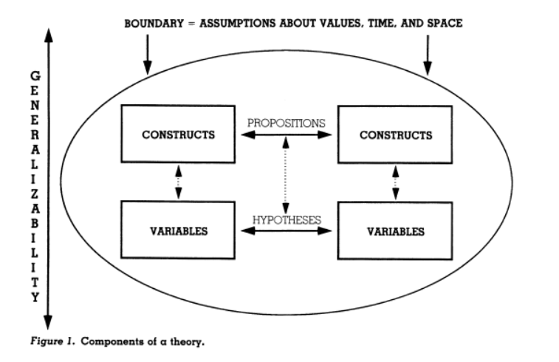

Slide 21
Sutton & Staw, 1995
“If a theory is particularly interesting, the standards used to evaluate how well it is tested or grounded need to be relaxed, not strengthened. We need to recognize that major contributions can be made when data are more illustrative than definitive (p. 382).”… “When theories are particularly interesting or important, there should be greater leeway in terms of empirical support (p. 383).”

Slide 22
A recent AMJ decision letter….
As you know, the degree to which an article offers a significant theoretical contribution is a major point of emphasis for AMJ. The goal is to change, challenge, or fundamentally extend our knowledge, causing us to think about organizational phenomena in a way that would not normally be anticipated from extrapolations of existing work, thereby advancing our understanding in an original and useful way. The mission statement stresses that authors should strive to produce novel, innovative, interesting, and theoretically bold research.

Slide 23
Corley & Gioia, 2011
“Perhaps more than any other criterion, originality stands out as the “dimension de rigueur” for AMR reviewers and editors” (p. 16).”
Although incrementalism improvement is arguably a necessary aspect of organizational research, especially in service to the contextualization of theory …. Current thinking at AMR and other top theory and research outlets seems to have shifted to a focus on theoretical contributions deemed to be more revelatory and nonobvious to organizational scholars (pp. 16-17).”

Slide 24
Corley & Gioia, 2011
“Surprises” “That’s interesting”
“a theorist is considered great not because his/her theories are [necessarily] true, but because they are interesting (Davis, 1971, p. 309).”

Slide 25
The counter argument
(Pillutla & Thau, OPR, 2013)
“the field’s focus on the ‘interesting’ (Davis, 1971) both in reporting on facts and in theories has also contributed to the fragmented state of the field. The demand that both theory and results should satisfy criteria of what is interesting, we argue, is antithetical to the scientific method and needs revisiting if we want to make progress. In particular, we contend that the focus on the ‘interesting’ has mutated into a focus on finding counterintuitive ‘facts’ and theories.”

Slide 26
Campbell, 1990
Better theory will be of immense value to both the science and practice of I/O psychology, but only as long as two things are kept in mind:
  Theory is not the dependent variable (is a valuable process, not a desired end-state)
  Form versus substance – the most elegant formalisms in all of creation cannot substitute for better ideas and better substantive paradigms. The medium is not the message. Better theories are simply better substantive ideas about what things mean, how things work, or what the serious problems are.

Slide 27
McDaniel
Theory: Perspectives from a Personnel Selection Researcher
A theory is a description or a model of a phenomenon that can be evaluated empirically.
Theories lie along a dimension of credibility.
Credible theories have empirical support through replications both exact and conceptual.
Our journals seldom publish replications (“nothing new here”) such that the credibility of many of our theories is in doubt.

Slide 28
McDaniel
Rather than replicating a theory-relevant result, the author behavior that is most rewarded is to come up with a new theory.
Our journals tend to reward new theories rather than replication efforts to find knowledge that is robust.
As such, the publication process in I/O psychology and management is dysfunctional and often a detriment to the trustworthiness of our cumulative knowledge.

Slide 29
McDaniel
Even with many replications, some of our field’s favored theories will likely be shown to be somewhat wrong.
This is because research counter to the theory has been suppressed through some combination of author and editorial decisions.

Slide 30
McDaniel
Authors often do not make papers available through journals or other accessible outlets when the paper does not support a theory.
Our journals tend not to accept papers with null or nil findings, which are the types of papers that could discredit a theory.

Slide 31
McDaniel
Also, our theories are often post-hoc explanations of data that have already been analyzed and consist of a story built to explain those results.
The story is then offered as a priori hypotheses. Many would find this to be unethical behavior.
Such results increase Type I error and may not replicate.

Slide 32
McDaniel
As support, see the work of O’Boyle et al. (2014, JOM) that tracks research from dissertation to journal article.
Unsupported dissertation hypotheses are often discarded and are replaced with new supported hypotheses. These are likely post hoc hypotheses presented as a priori.
As such, the researcher is often less of a scientist and more of a creative writer.

Slide 33
McDaniel
A good default position is that all theories must be at least somewhat wrong.
One goal of a scientist is to conduct research that can be used to make a theory less wrong or at least to identify the boundary conditions for where the theory is more correct and where the theory is more wrong.

Slide 34
McDaniel
I feel fortunate that my primary research area is personnel selection because its theories are generally straightforward, easy to test, and easy to refute.
Replication studies are common.
It is not hard to evaluate a theory that argues that job performance is a function of job knowledge, which in turn is a function of general cognitive ability and job experience.

Slide 35
McDaniel
It is not hard to evaluate a theory that argues that the best predictor of future performance is past performance.
In personnel selection, thankfully, theories have not generally proliferated in the dysfunctional manner such as found in most of the applied psychology and management journals.

Slide 36
1. What makes for a good theory or a bad theory?
Questions
Notes:
NICKLIN – pose question (and follow-ups if necessary)

Slide 37
2. Should papers and conference presentations be required to make a theoretical contribution?
Questions
Notes:
NICKLIN – pose question (and follow-ups if necessary)

Slide 38
3. Is big data the answer to this predicament? Why or why not?
Questions
Notes:
NICKLIN – pose question (and follow-ups if necessary)

Slide 39
4. Academics in management seem to have a different interpretation of theory than the scientific community. Should I/O follow the scientific community, the management community, or allow authors to decide which path to follow in their papers/presentations?
Questions
Notes:
NICKLIN – pose question (and follow-ups if necessary)

Slide 40
5. Should practitioners implement management theories (i.e., those consisting of propositions and hypotheses without empirical support) or wait for scientific theories to emerge (i.e., those with empirical support)?
Questions
Notes:
NICKLIN – pose question (and follow-ups if necessary)

Slide 41
6. What can be made of a study that has a strong and reliable empirical finding but no a priori “theory” besides a plausible hypothesis?
Questions
Notes:
NICKLIN – pose question (and follow-ups if necessary)

Slide 42
Question and Comments from the Audience
Notes:
NICKLIN

